Slide 1
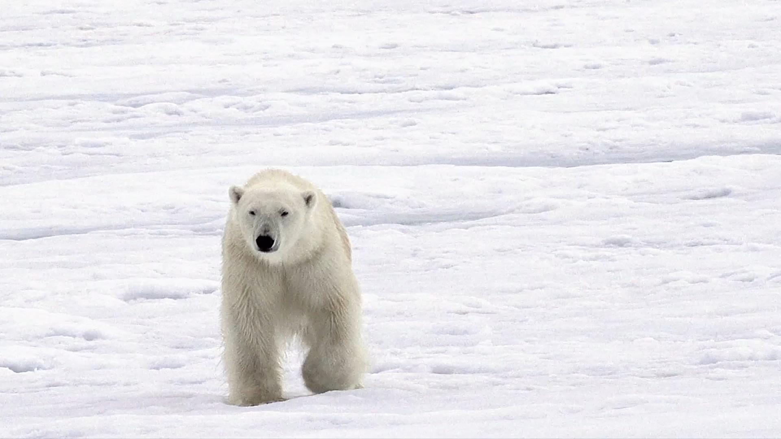
Intro to Polars
Center for Data and Visualization Sciences
Joel Herndon joel.herndon@duke.edu
January 16, 2024
Notes:
Welcome! This presentation will last about an hour or so. I’ll linger for questions. My backgound in Polars/Python. Please ask questions during presentation. We’ll have 3 sections.

Slide 2
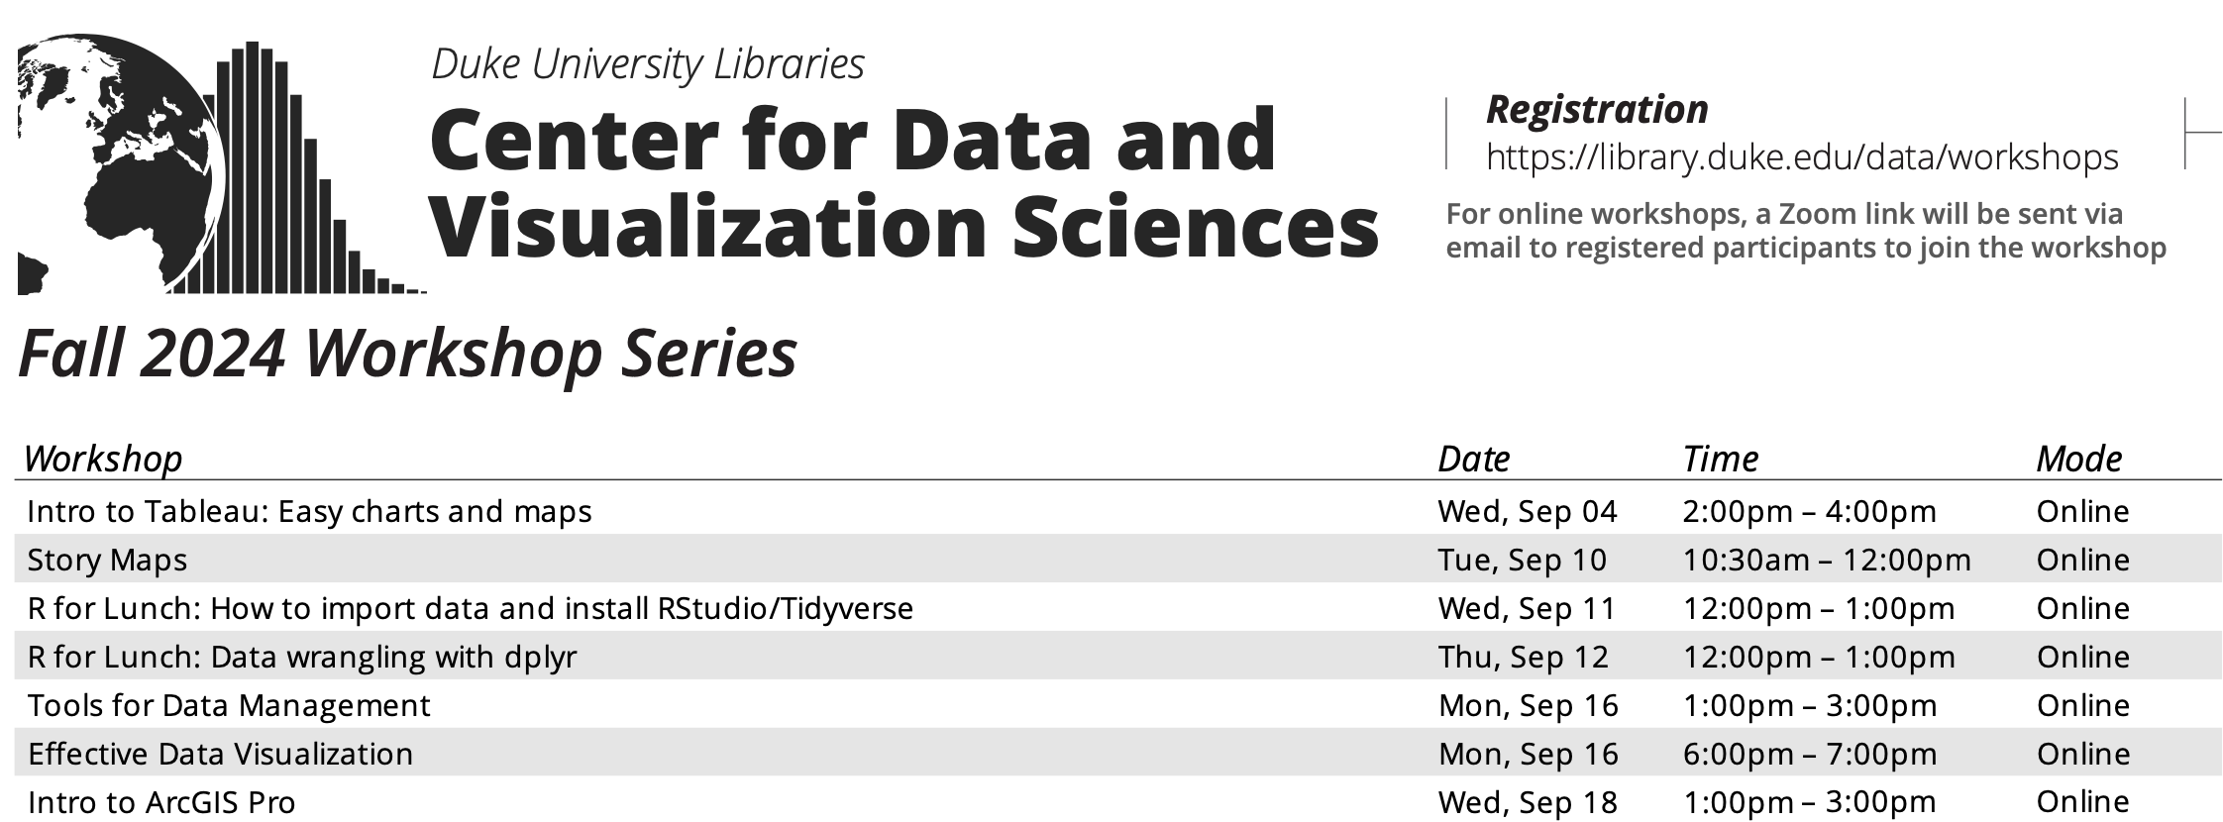
library.duke.edu/data/workshops

Slide 3
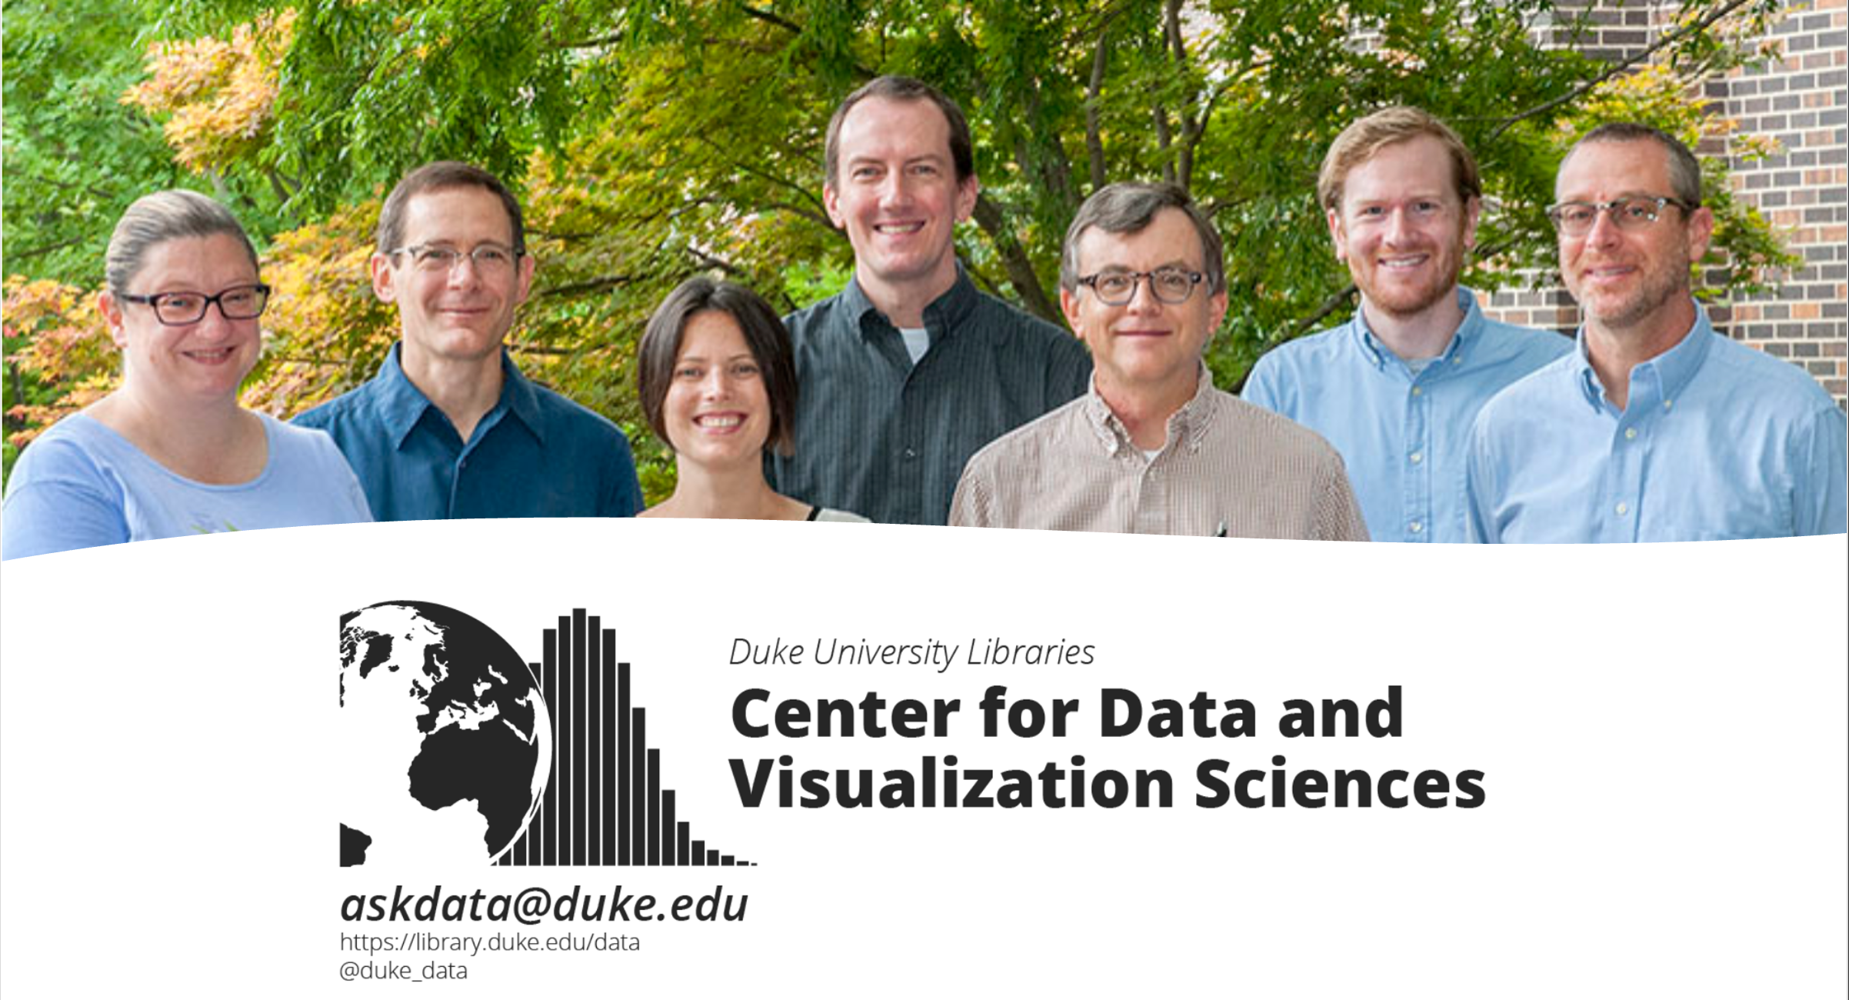

Slide 4
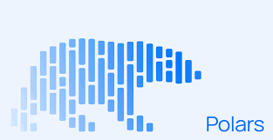
Intro to Polars: Workshop Materials
Workshop materials: bit.ly/polars_jan16
Google Colab: colab.research.google.com
Get help: askdata@duke.edu

Slide 5
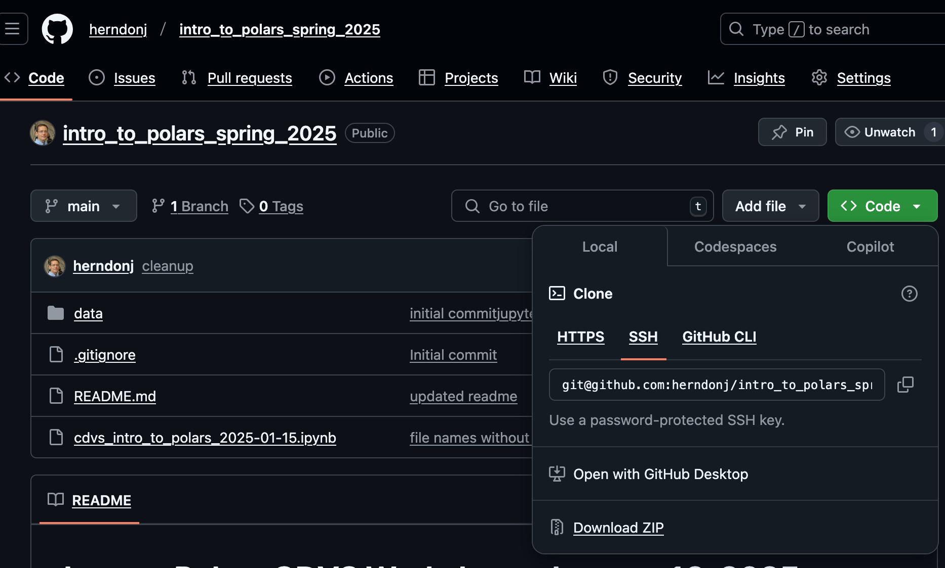
1. Click here
2. Then, click here…

Slide 6
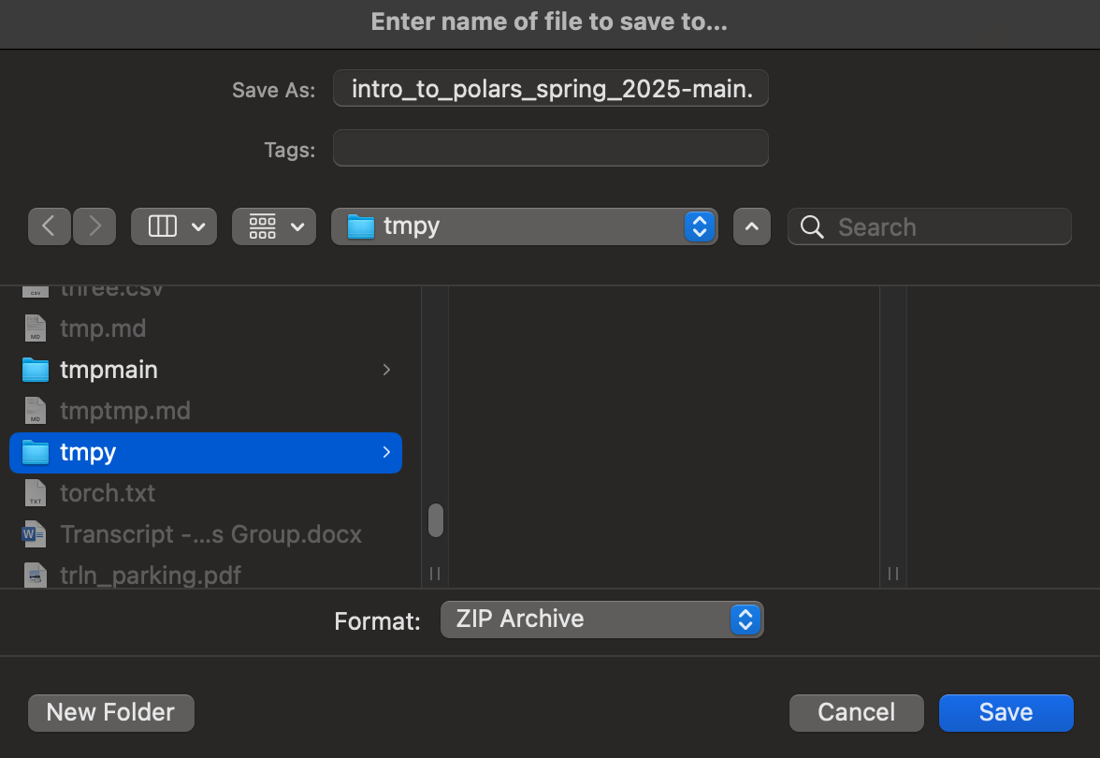
3. Keep track of the where you save and uncompress the file!

Slide 7
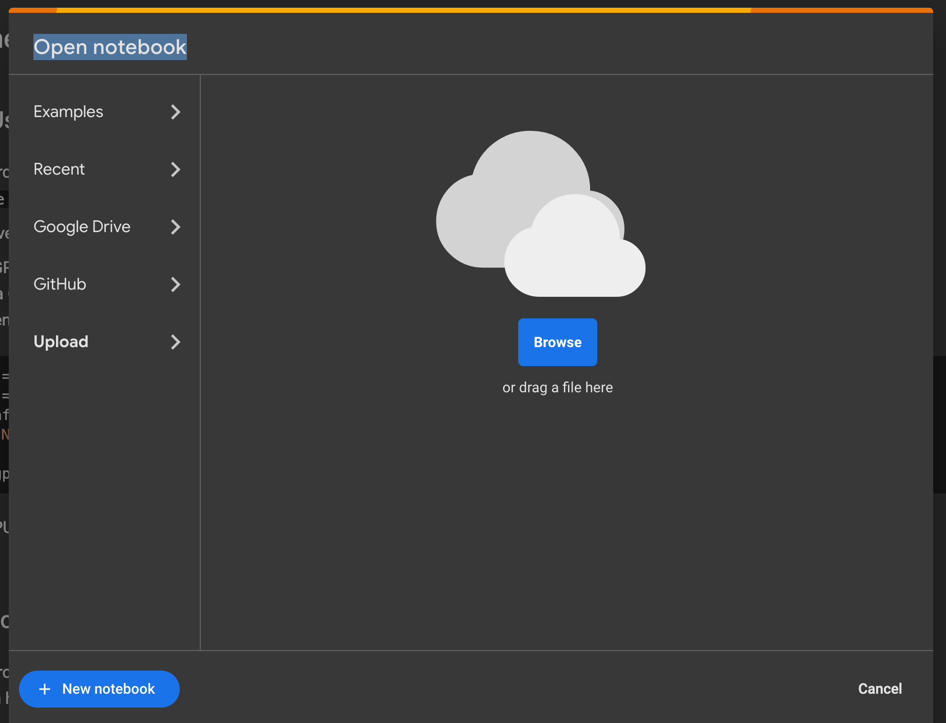
colab.research.google.com
2. Then, click here…
1. Click here

Slide 8
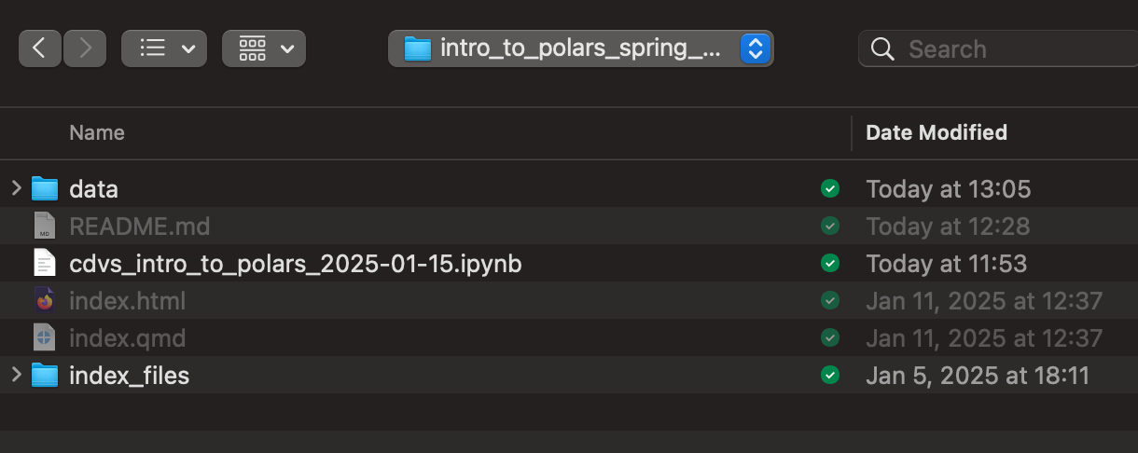
1. In the folder you downloaded: select “cdvs_intro… .ipynb” (see below)

Slide 9
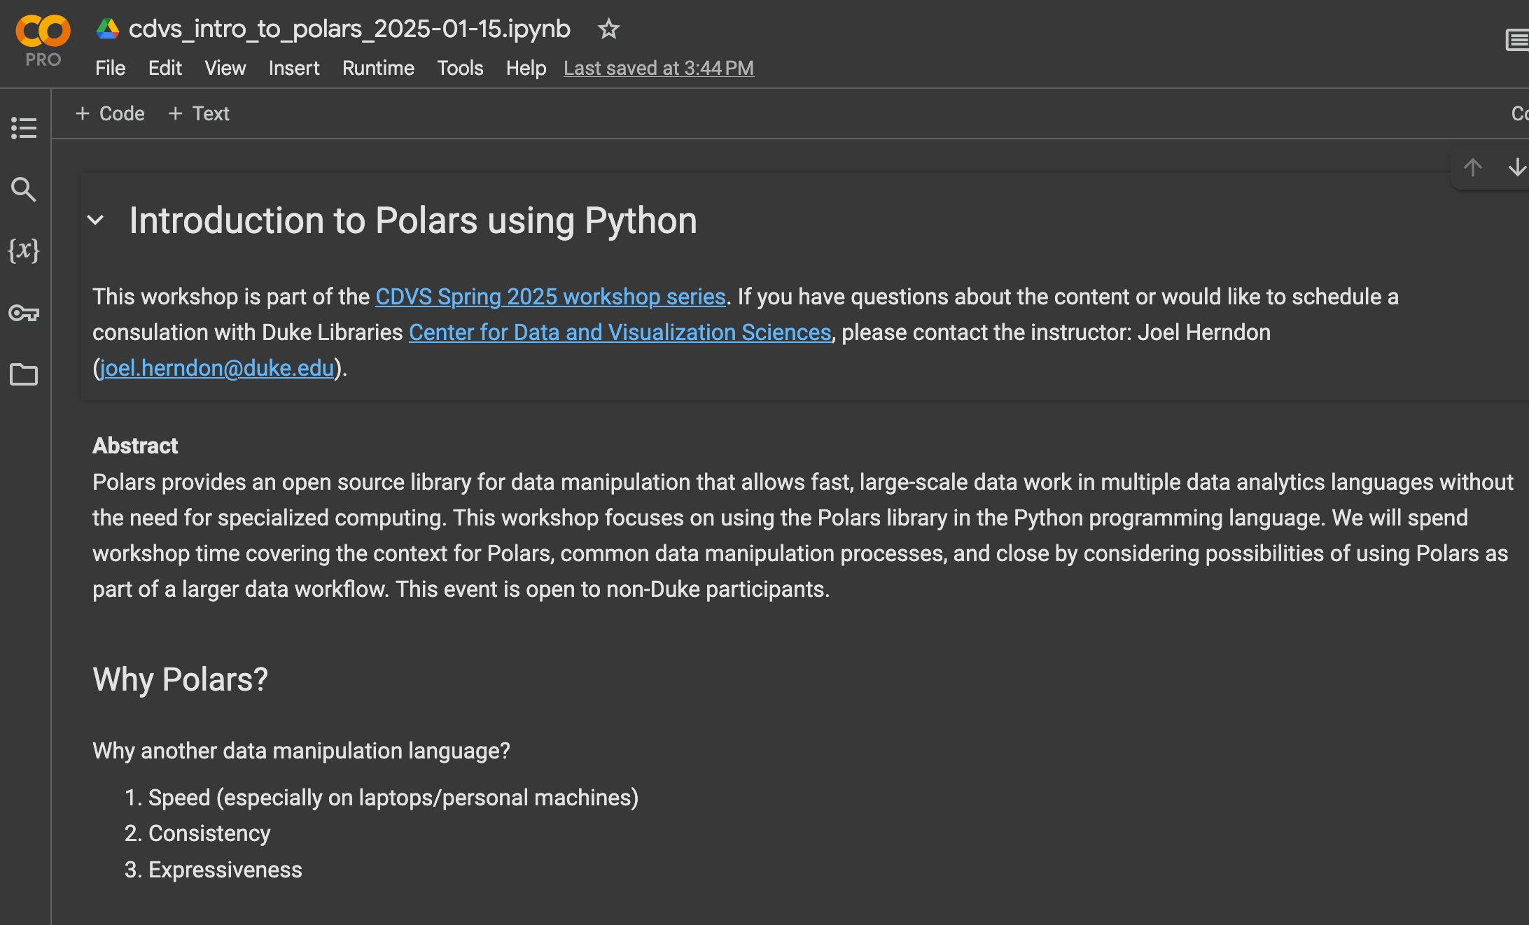
Success!

Slide 10
Workshop
1. Ask questions as you have them! All (respectful) questions are welcome!
2. The workshop goal is to demonstrate enough Polars so that you can determine if it might be useful for your work. We’ll open with an introduction, explore common methods, and close with some thoughts on workflows.
3. We’ll use simple examples, but Polars is capable of very complex work (the workshop is limited to an hour... but polars capabilities are expansive!)
4. I’ll present using Google Colab in the live workshop. Please consider using a python development environment for further polars explorations.
5. Your feedback is appreciated! I’m happy to talk or please fill out a survey form.

Slide 11
Why Polars?
Speed
Strictness (or consistency)
Expressiveness
“Come for the speed, stay for the API” – Janssens and Nieuwdorp, 2025

